Slide 1

The Nelson Mandela African Institution of Science and Technology
Course Name: Research Methods and
Communication
Course Code: 6001
(Lecturer: Elizabeth Mkoba, PhD)
Learning Unit 6: Research Ethics and Plagiarism

Slide 2
Read This Slowly by Jakewoodard
“The Universe responds to your frequency. It does not recognize your personal desires, wants or needs. It only understands the frequency in which you are vibrating at.
For example,
If you are vibrating in the frequency of fear, guilt or shame, you are going to attract things of similar vibration to support that frequency.
If you are vibrating in the frequency of love, joy and abundance, you are going to attract things to support that frequency.
It is like tuning into a radio station. You have to be tuned into the radio station you want to listen to just like you have to be tuned into energy you want to manifest in your life”.

Slide 3
LEARNING OUTCOMES
Students should be able to:
Explain what ethics is
Explain what research ethics is.
Describe when ethical approval might be needed.
Describe how research can forge ethical approval.
Describe ethical consideration.
Describe reliability and validity of data
Explain what plagiarism is.

Slide 4
LEARNING UNIT 2 ASSESSMENT CRITERIA
Students should be able to:
Understood what ethics is
Understood what research ethics is.
Understood when ethical approval might be needed.
Understood how research can forge ethical approval.
Understood ethical consideration.
Understood reliability and validity of data.
Understood plagiarism.

Slide 5
Are we doing research ethically?
In fact, research misconduct is by itself a field of research!.
A Google Scholar search reveals that, between 2000 and 2017, 7530 articles were published on research misconduct and 7470 on scientific misconduct.
Reference
Kornfeld, Donald S. MD "It’s Time for Action on Research Misconduct." Academic Medicine: August 2018 - Volume 93 - Issue 8 - p 1103.

Slide 6
What is ethics?
Ethics is about right and wrong. It is a norm for conduct (code of conduct) that differentiates between acceptable and unacceptable behavior.
Ethics are the principles that guide us to make a positive impact through our decisions and actions.
Ethics play an important role not only in our personal lives but also in research. We are all encouraged to make ethical choices and apply ethics in all areas of our lives.
Do you think AI can become ethical? Can ethics be programmed into a machine?

Slide 7
Research Ethics
Research ethics govern the standards of conduct for scientific researchers and research activities.
It is important to adhere to ethical principles in order to protect the dignity, rights and welfare of research participants.
Practicing ethical guidelines while conducting and reporting research is essential to establish the validity of your research.
You must adhere to ethical guidelines also while presenting your findings in your manuscript, dissertation, conference papers etc.

Slide 8
Research Ethics …
Ethical concerns are not only limited to research practices and the classic norms of research protection and authorship recognition, but also encompass subjects and participants, where harm must be minimized, confidentiality must be guaranteed and a transparent participation process must be carried out, with informed consent, situations that go hand in hand with the "integrity of research" .

Slide 9
Research Ethics …
Research ethics and research integrity have similar concepts, where both are focused on the researcher's ethical behavior in terms of:
obtaining the information and reporting the results,
highlighting that research integrity refers mainly to the fact that the processes that have been carried out before, during and after obtaining and analyzing the data have been carried out in an ethical manner.

Slide 10
Policies /Guidelines of Research Ethics
Ethics committees play an important role in defining the standards that need to be met for research ethics and ensuring that they are met.
Universities, Research Centres and Countries do have Policies/Guidelines of Research Ethics.
For example, Some influential policies relating to research ethics include those introduced in USA by:
the National Institutes of Health (NIH),
the National Science Foundation (NSF),
the American Chemical Society, or
the European Network of Research Ethics Committees.
Other guidelines such as the World Medical Association’s Declaration of Helsinki have been fundamental in defining human research ethics.

Slide 11
When ethical approval might be needed?
Research which involves human or animal participants the following should usually go through ethical approval before data can be collected:
Gathering information about human beings through interviews, focus group discussion, surveys using questionnaires
Observing human behaviour, recording audio or video
Collecting or using human tissue/bone/blood or other body fluids
Conducting clinical trials
Using archived data in which individuals are identifiable

Slide 12
Forging Ethical Approval
A case of forging ethical approval
In 2019, a scientist was found guilty of illegally trying to alter the genetic makeup of twin girls. He apparently embarked on this research after forging documents from an ethics review panel.
“Chinese scientist who edited babies' genes jailed for three years”
You can read about it in
https://www.theguardian.com/world/2019/dec/30/gene-editing-chinese-scientist-he-jiankui-jailed-three-years

Slide 13
Ethical Consideration
Ethical considerations are important in research which involves human subjects.
Explain about:
Research Approval: How will you obtain approval to conduct a research/study.
Informed consent: Voluntary participation of the respondents in your study
Confidentiality and anonymity: Maintain the confidentiality of participants
Ethical interpretation and reporting results: Researcher is obligated to produce reports that cannot lead to the identification of respondents.
Note: Ethical Consideration is a section in the Research Methodology Chapter (refer to the research proposal layout document)

Slide 14
Reliability of Data
RELIABILITY TEST
Reliability refers to the ability of the instrument to yield the same consistent results in a repeated testing period.
The internal consistency has been used to measure questionnaire reliability. For example The Cronbach‘s alpha coefficient is used to test the reliability of the questionnaires. The Cronbach’s alpha coefficient of 0.7 and above is accepted as representing good reliability.
If there is consistency of measured items, the data collection instrument is reliable and data can be trusted.

Slide 15
Validity of Data
VALIDITY
Validity refers to the appropriateness of the questionnaire to measure what it intends to measure.
The various validity tests, which are used to assess a survey questionnaire, are face, content, criterion and construct validity. For example if you use the content validity test. Content validity assesses the degree to which individual variables represent the construct being measured. Content validity can be tested using:
Experts to review the survey instrument or interview guide to ensure that the appropriate data were collected.
Pilot testing of the data collection instrument before administering to a larger sample.

Slide 16
Plagiarism
Fabrication, falsification, and plagiarism (sometimes referred to by the abbreviation FFP) are the most common types of research misconduct.
A shopkeeper cleverly changes the "sell by" or expiry date on food items so they can be kept longer on the shelf. Data falsification
A student copies paragraphs from a textbook to answer questions in an assignment, because she thinks it is fine to do so. Unintentional plagiarism
A student has not studied for his examination and copies the writing of his neighbor in the exam hall when no-one is looking. Intentional plagiarism
A professor is on the selection committee for a scholarship for which her nephew is applying. Potential conflict of interest

Slide 17
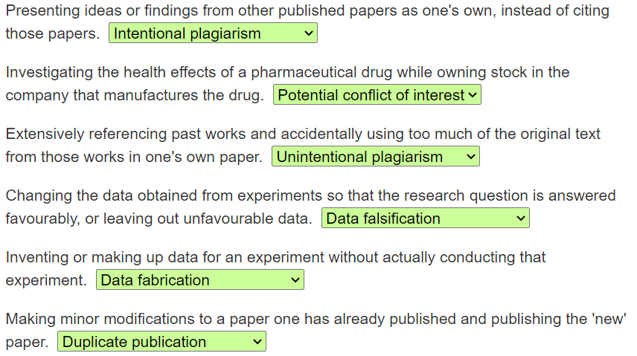
Plagiarism …
'Falsify‘ (Falsification) means to modify something to make it different from what it actually is.
Fabricate‘(Fabrication) means to invent something without any basis in fact.

Slide 18
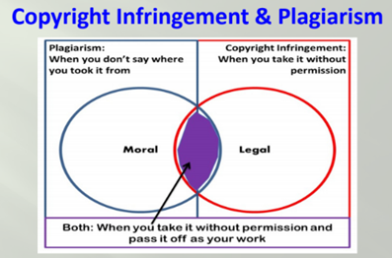
Plagiarism …

Slide 19
Plagiarism …
Plagiarism Software
Turnitin is an Internet-based plagiarism detection service run by the American company Turnitin, LLC. It was found in 1998.
It sells its licenses to universities and high schools who then use the software as a service (SaaS) website to check submitted documents against its database and the content of other websites with the aim of identifying plagiarism.

Slide 20
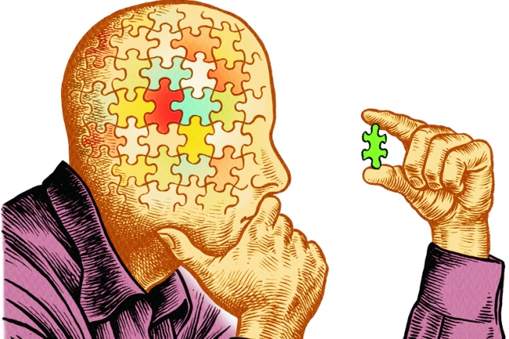
…End…

